Slide 1

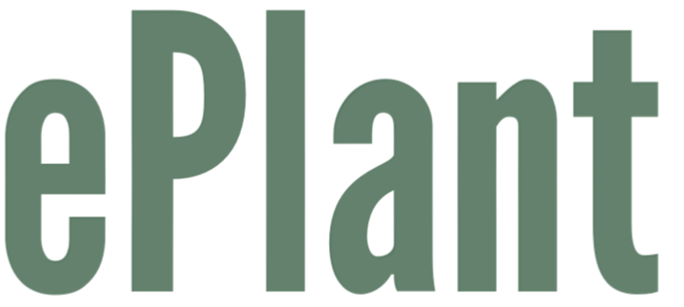

Slide 2
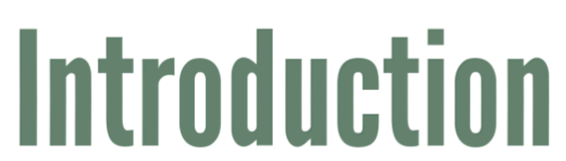
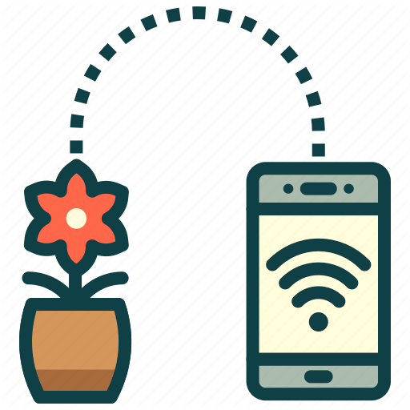
The aim of the project was to create an automatized pot that has been programmed to answer the specific needs of a certain plant.
The controlling of the smart pot happens with a mobile application that we have developed.
Our purpose is to ease people's everyday lives and to help them keep their plants alive.

Slide 3


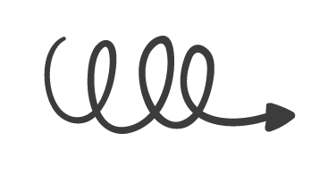

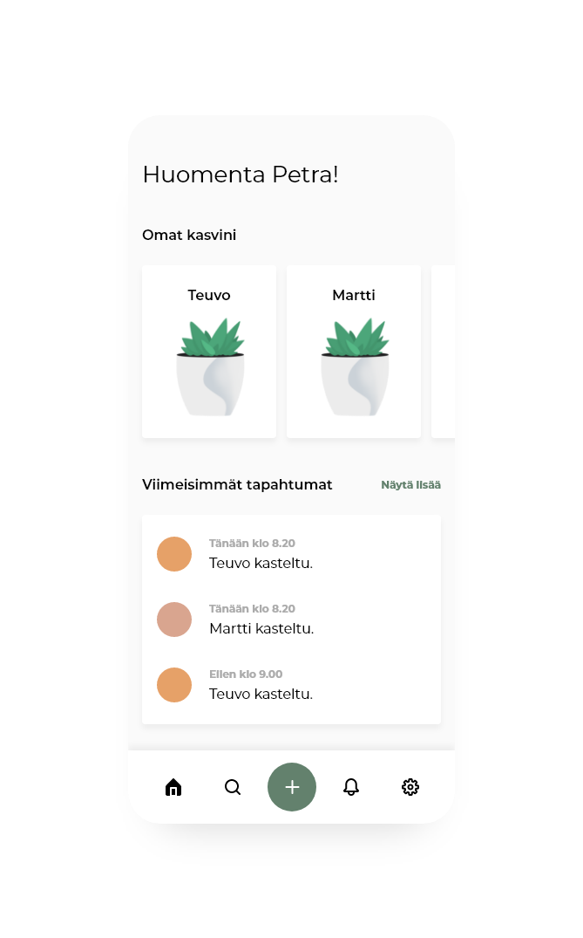
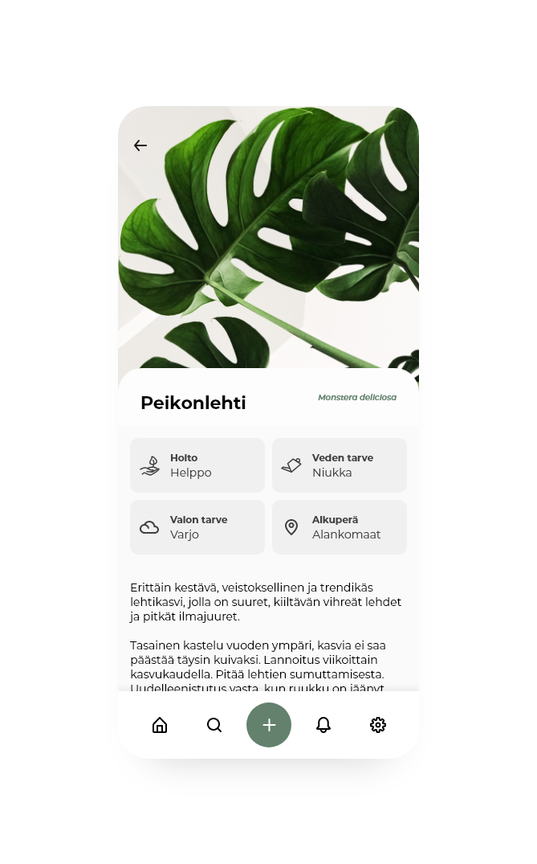

Design workshop based on Sprint book
Clean and intuitive design
Following your own plants
Searching plants, and information about them
History of latest events
Adding new plants
Following my own Plants
Humidity of the soil
Water tank status
History
Watering plant manually
Adjusting the watering
Community
AI
Notes:
For identifying the main features, goal and obstacles we had design workshop that was based on the Sprint books 5 days design sprint
We wanted to create simple and effortless user experience and use earthy colors that suit the theme of the app
So for the main features we identified these kind of functions
Following the state of your own plants, we will focus soon on what does this mean
Searching different plants, for example if user wants to buy a new one, they can find info about it
History of the latest events, so for example when have plants been watered
Adding a new plant, where user can select the added plant from the database, select a pot and give plant a name
Then more about Following your own plants, from the application you can follow these things:
Humidity of the soil
Pots water tank status
History about when was the last watering
Option to water the plant manually

Slide 4
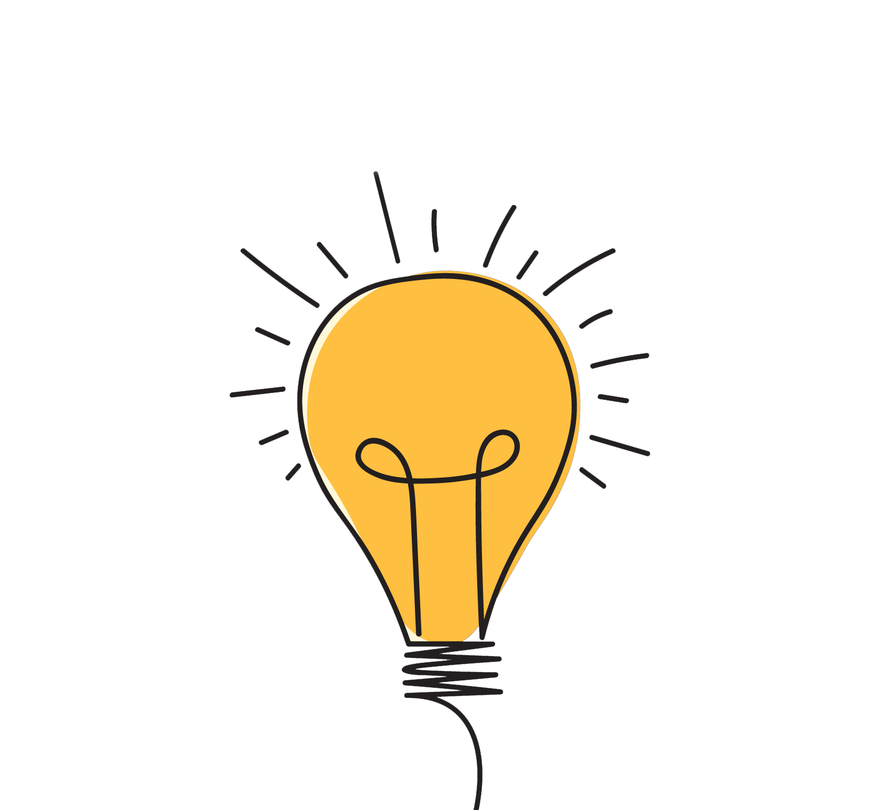
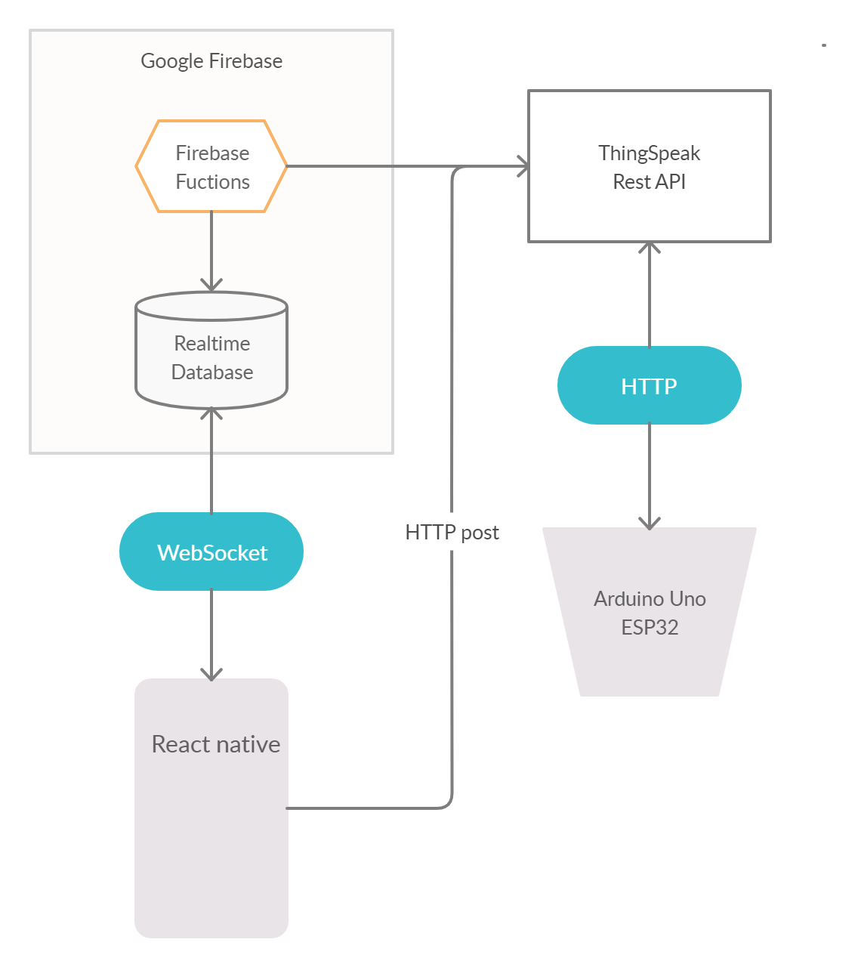
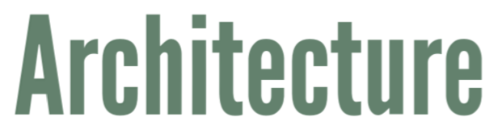
First, we were supposed to use Microsoft Azure as a platform, but it turned out to be too expensive for this project.
So we decided to change to Google Firebase which is similar to Azure.
The basic idea here is to push and store the IoT device’s data to the cloud and then fetch it in the react-native app.
To send commands to the IoT device, the react-native app sends HTTP post request to Thingspeak, which processes it and then sends it to Arduino Uno.

Slide 5

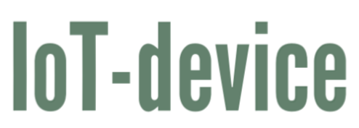
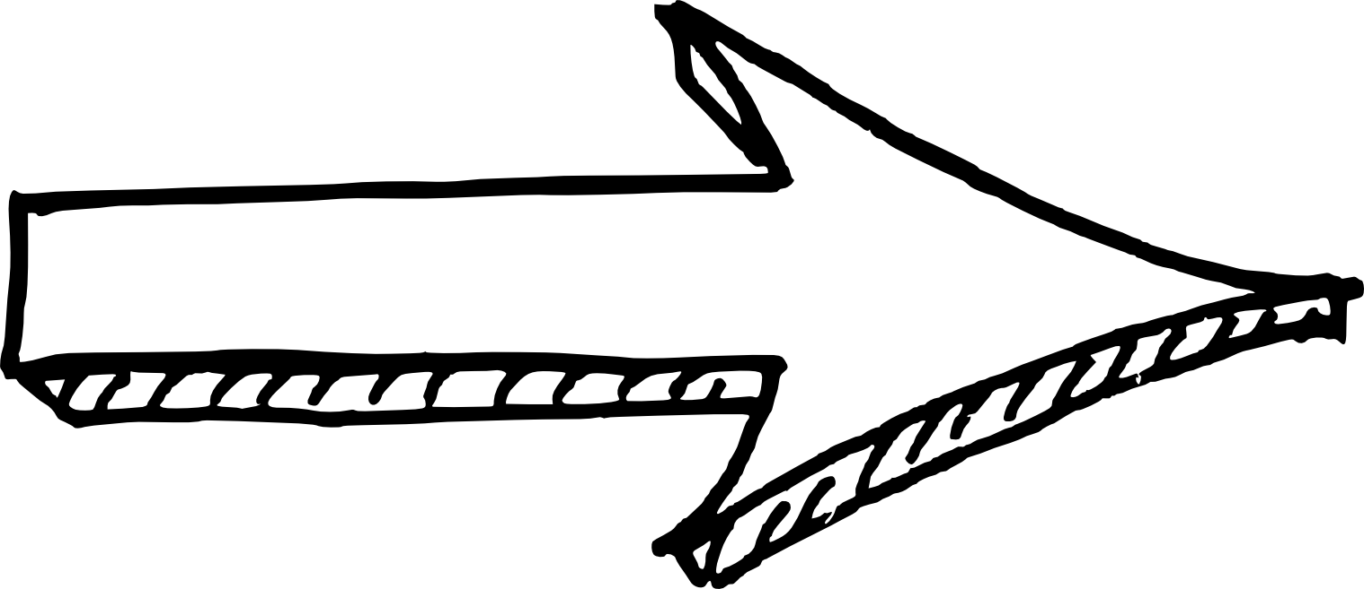

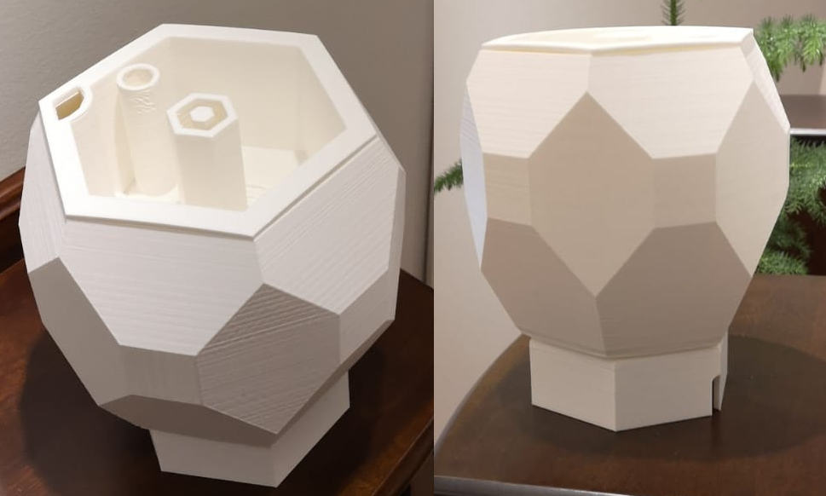

IoT-device consists from three different 3D-modeled and printed parts: the outer pot, the inner pot and a specified place for all components.
Software environment: Arduino
Programming language: C++
Development platform: ESP32 (controls the functionality)
The humidity sensor measures the moisture in the soil.
When the soil is too dry, the water pump will activate.
Water level sensor measures the water level in the outer
pot (water tank) and activate the pump if the specified value has
fallen.
The outer pot is used as a water tank. A water level sensor is
attached to the wall, which measures the height of the water level.
The soil and the plant itself are placed in the inner pot.
The watering happens through the hole that is placed in the middle
of the pot. The water tank can be filled from the hole at the edge of
the inner pot.
ESP32 and other components are placed in the bottom of the pot.
The smart pot is connected to Wifi but also works stand-alone.
*
* Internet of Things (IoT) = ”A network of Internet connected objects able to collect and exchange data.”

Slide 6
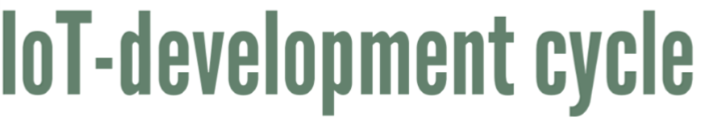
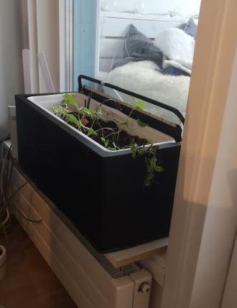
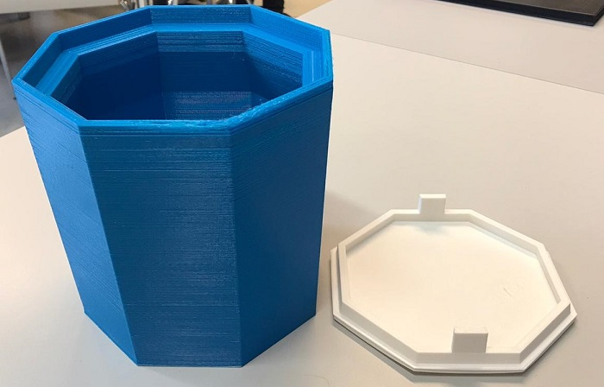


Made out of metal
First time 3D-printed
First working prototype
No wiring tunnels
Watering system
No watering systems
Test size
Lights and light sensor

Slide 7
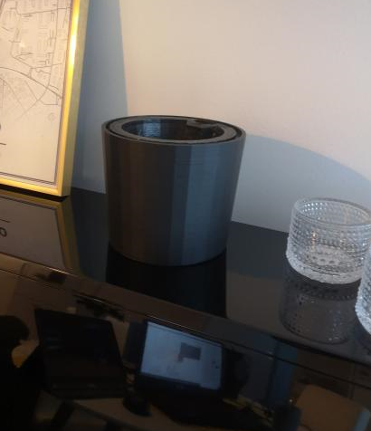
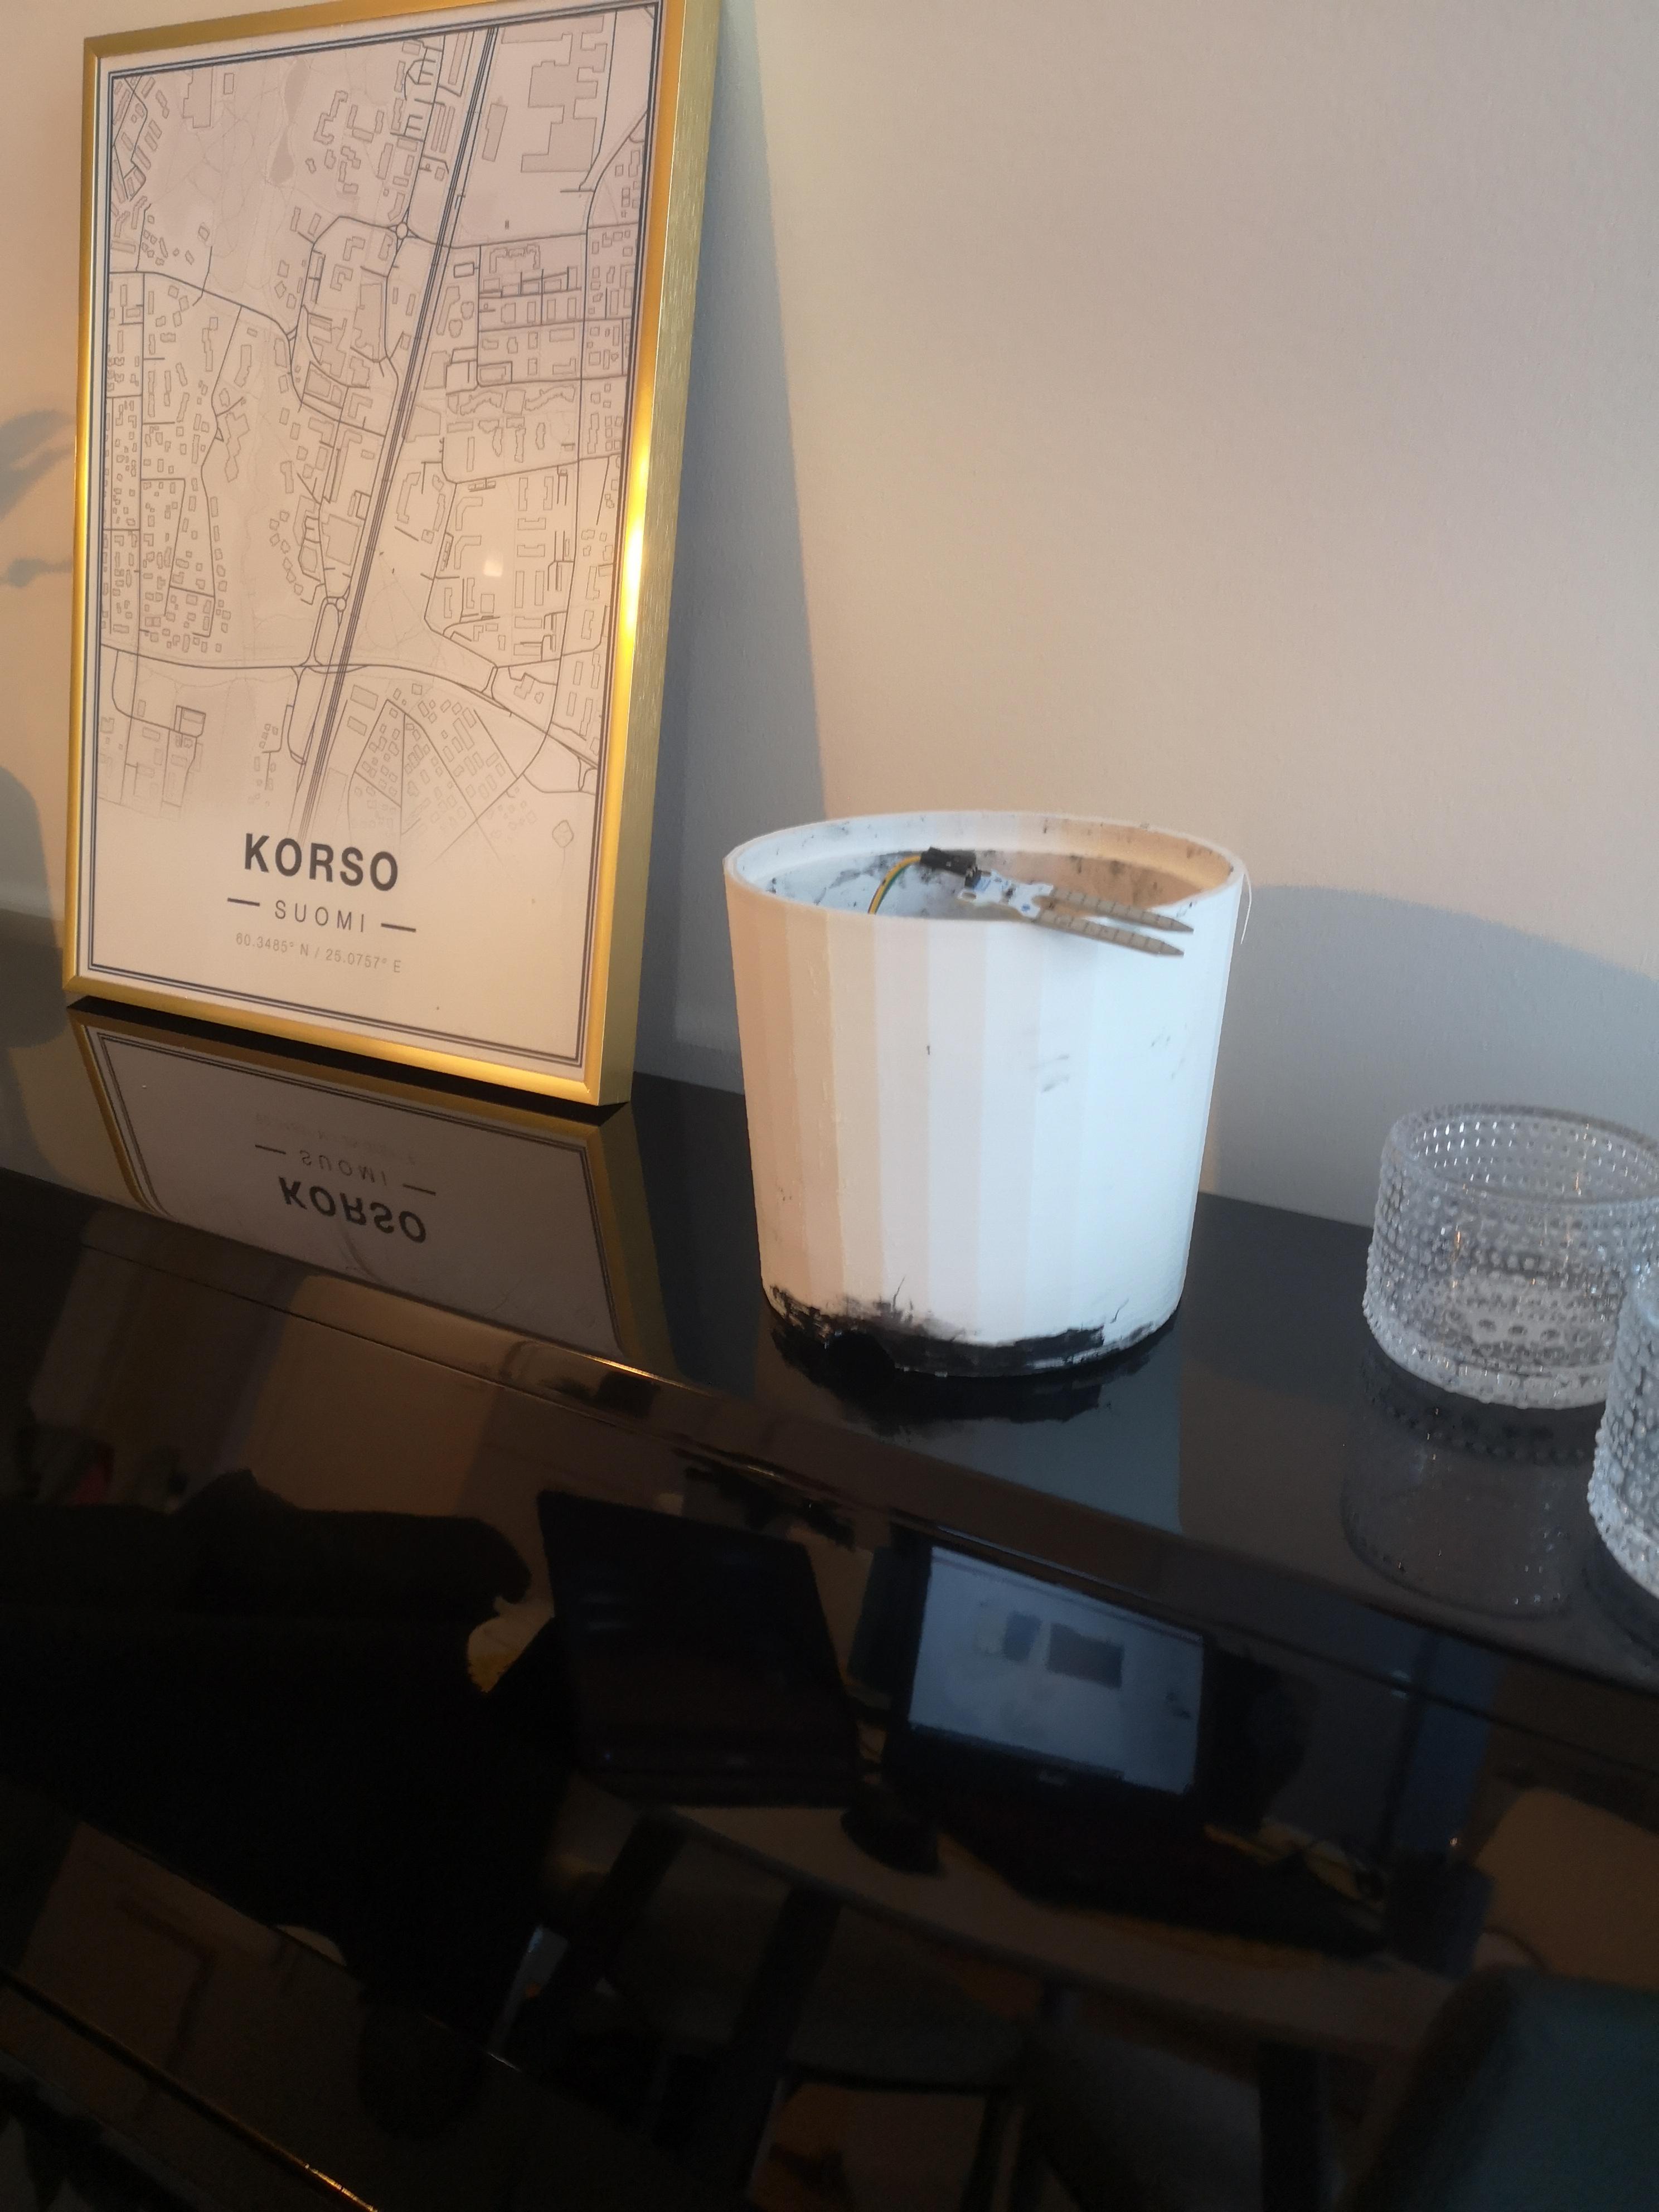


Complete plant pot
New print with bigger space for tech
Watering system prototype
Working prototype
Wiring spots
Still too little space for tech
Too small space for tech
Version 5. Online found plant pot

Slide 8

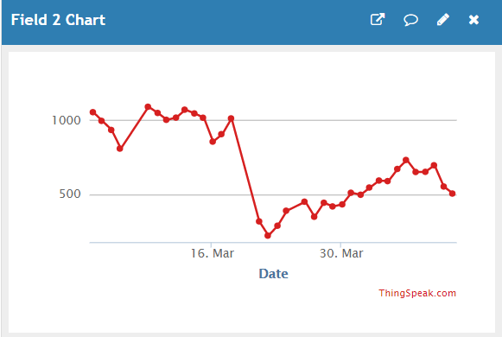
ThingSpeak is an IoT analytics platform service that allows to send and receive live data from an IoT-device and visualize it in the cloud.
The smart pot works with a Wifi connection through which it sends continuously data (such as soil moisture and water levels) to ThingSpeak.
The smart pot can be controlled from the mobile application by using the ThingSpeak API-keys.

Slide 9
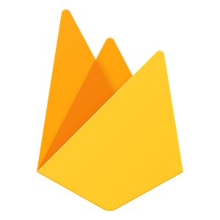
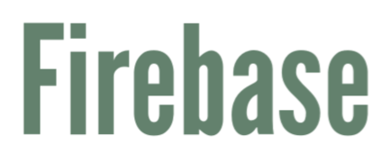
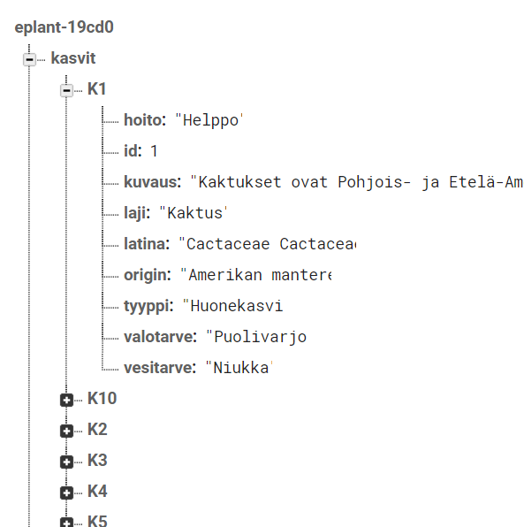


Realtime database for our two tables
Easy, fast and free
Storing information
Filtering based on different parameters
Authentication in the future
Maintenance
Id
Description
Species
Latin name
Origin
Type
Need of light
Need of water
Id
Name
Plant
Notes:
So for our database we are using Google Firebase platform, and we are using the real time database where we have two tables
We use firebase because it's quick, easy and free
We use it mostly to store data
But it also allowes us to for example filter information based on different parameters, for example we can show just certain kind of plants
Also Firebase has authentication service, that could be maybe implemented to the application in the future
And here we have screenshot of the data we have in firebase and just the keys in English
So we have 2 relations Plans and Pots, we have so far mainly focused on implementing the plans and have brought some data from there to application already
There we have this this this and this..
And for the Pots, these are the plants that the user has saved for the application, name, plant and the id of it.

Slide 10
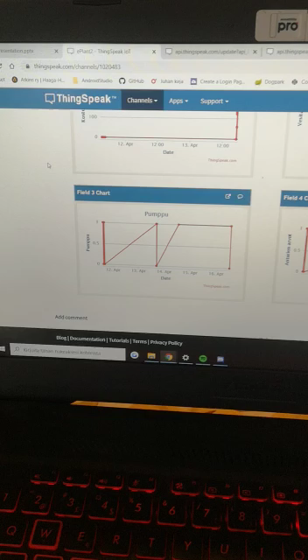


Slide 11


ePlant emulator

